Slide 1
Project Class Diagram
Hassan Abbas i210507 BSCS B

Slide 2

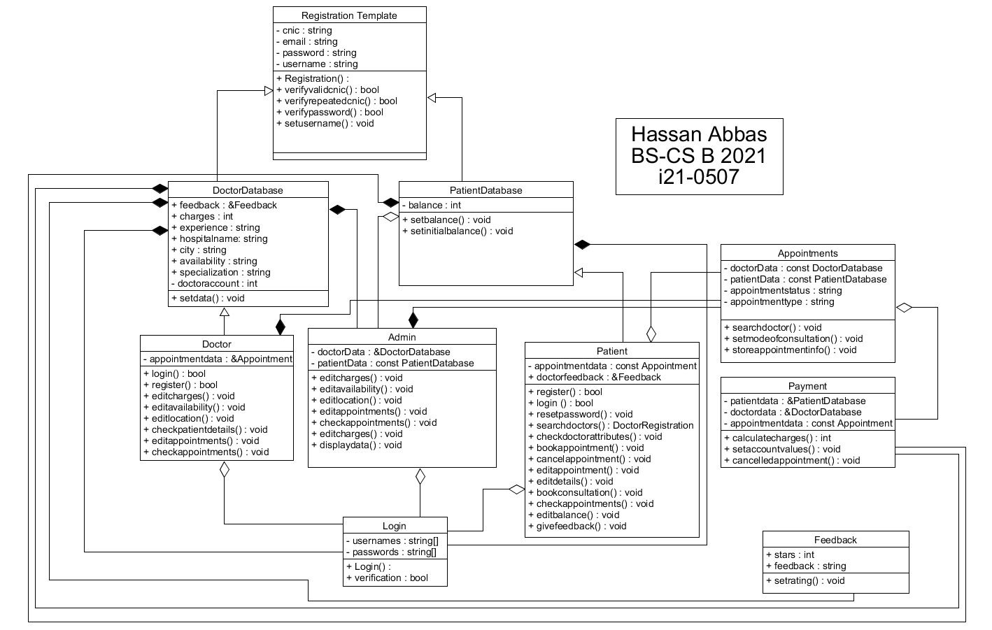

Slide 3
Registration Template
This acts as a template for storing data members for doctor and patient data base classes

Slide 4
Doctor Database
It contains total attributes required for doctor class and functions for implementing required functionality

Slide 5
Patient Database
It is similar to doctor database

Slide 6
USER classes
3 user classes DOCTOR, PATIENT & ADMIN
All 3 can perform different functions of DATABASE containing classes according to requirment

Slide 7
LOGIN
This class acquires login and password attributes dynamically linked from registration class for functionality

Slide 8
Appointments, Payment, Feedback
Appointment gets data from doctor database and patient database also user classes so does Feedback and Payment and they use or manipulate this data according to requirement
Feedback can manipulate data in database classes
Payment can also manipulate data

